Slide 1
Gesture Controlled Virtual Mouse and Keyboard using OpenCV
VIDYA JYOTHI INSTITUTE OF TECHNOLOGY (Autonomous)
By:
Priyadarshini. A [19911A3502]
Balakrishna. C [19911A3511]
Shri Akshita. G [ 19911A3547]
Under the guidance of
Dr. Md. Nazeer
Associate Professor

Slide 2
Overview
Problem Statement
Abstract
Introduction
Literature Survey
Existing System
Proposed System
Methodology
Results
References
Department of Artificial Intelligence

Slide 3
Problem Statement
To provide a hands-free and convenient way to interact with computers.
An increased demand for contactless technologies during the COVID-19 pandemic
Increased productivity.

Slide 4
Abstract
Make human-computer interaction easier and virtually control all input and output processes.
Contemporary approaches in machine learning and computer vision are employed.
Uses a CNN-like model implemented by Media Pipe running on top of pybind11.
Variety of modules employed includes Hand Tracking,CVzone Hand Detector Modules and Controller.
No necessity of a wire or any other external device.

Slide 5
Introduction
People with physical impairments face many difficulties .
We proposed a novel, multimodal interactive keyboard and mouse system.
Takes inputs from a camera using vision-based and hand gesture recognition techniques.
Allows the user to operate their computer’s keyboard and mouse using their hand,eye and voice.

Slide 6
Literature Survey
Virtual Mouse Control Using Colored Fingertips and Hand Gesture Recognition Vantukala VishnuTeja Reddy; Thumma Dhyanchand; Galla Vamsi Krishna; Satish Maheshwaram -2020
(DOI:10.1109/HYDCON48903.2020.9242677)
Virtual mouse is implemented with finger tip recognition and hand gesture recognition based on image in a live video using colored caps.
Real-time virtual mouse system using RGB-D images and fingertip detection
Dinh-Son Tran, Ngoc-Huynh Ho, Hyung-Jeong Yang, Soo-Hyung Kim & Guee Sang Lee - 2021
(DOI: https://doi.org/10.1007/s11042-020-10156-5)
Virtual mouse is implemented using RGB-D images and fingertip detection. Hand region and center of the palm are extracted using in depth skeleton-joint information from a Microsoft Kinect sensor version.

Slide 7
Literature Survey
Deep Learning-Based Real-Time AI Virtual Mouse System Using Computer Vision to Avoid COVID-19 Spread S. Shriram,1B. Nagaraj,2J. Jaya,3S. Shankar,4 and P. Ajay 5-2021
(DOI: https://doi.org/10.1155/2021/8133076)
The algorithm used in the system makes use of the machine learning algorithm. Based on the hand gestures, the computer can be controlled virtually and can perform left click, right click, scrolling functions, and computer cursor function without the use of the physical mouse. The algorithm is based on deep learning for detecting the hands.
Hand gesture recognition-based non-touch character writing system on a virtual keyboard
Md. Abdur Rahim, Jungpil Shin & Md. Rashedul Islam-2020
(DOI:https://doi.org/10.1007/s11042-019-08448-6)
This paper proposes a non-touch character writing system that allows users to interact and manage the on-screen virtual keyboards in a secure and healthy way by recognizing a few hand gestures. We divide this work into two parts: a) hand gesture recognition; b) gestural flick input using a virtual keyboard.

Slide 8
Literature Survey
Computer Cursor Control Using Eye and Face Gestures Akshada Dongre; Rodney Pinto; Ameya Patkar; Minal Lopes-2020
(DOI: https://ieeexplore.ieee.org/document/9225311)
In this system after the input is taken from the user, the real-time video input is processed and face recognition is performed. A point on the user's face would control the cursor on the screen and the right and left wink would implement the right and left click respectively. Squeezed eyes would facilitate the enabling of the scroll function in case of reading PDFs and other documents.
A New Virtual Keyboard with Finger Gesture Recognition for AR/VR Devices Tae-Ho Lee & Hyuk-Jae Lee - 2021
(DOI:https://doi.org/10.1007/978-3-319-91250-9_5)
A virtual keyboard is designed in a multi-tab method of 3 × 4 arrays that are widely used in a mobile environment using Convex-Hull and Keyboard layout optimization.

Slide 9
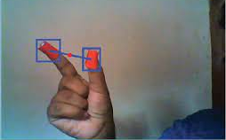
Existing System
In the existing system, the process of implementation can be started when the user's gesture was captured in real time by the webcam and we can control mouse and keyboard virtually using hand gestures. It is divided into two methods:
fingertip detection using colored caps
gesture recognition
Drawbacks
We cannot use colored gloves all the time.
Not accurate at finger tracking at a longer distance.
Doesn’t work well in complex backgrounds.

Slide 10
Proposed System
In the proposed system, the process of the implementation can be started when the user's gesture was captured in real time by the webcam, after which the captured image will be dealt with segmentation process to compare and separate the value of pixels to the values of the defined colour.
The input information is acquired via a webcam and processed using the proposed model. The workflow is divided into four features:
Virtual keyboard
Voice commands
Eye movements
Hand Gestures
TECHNOLOGIES USED
Python
OpenCV
Tkinter

Slide 11
Methodology
Involves utilizing the Media Pipe library to process real-time video input from a camera.
Machine learning techniques could be used to train a model to recognize gestures based on landmarks.
The resulting output could be used to control a virtual mouse and keyboard.

Slide 12
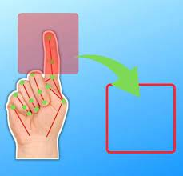

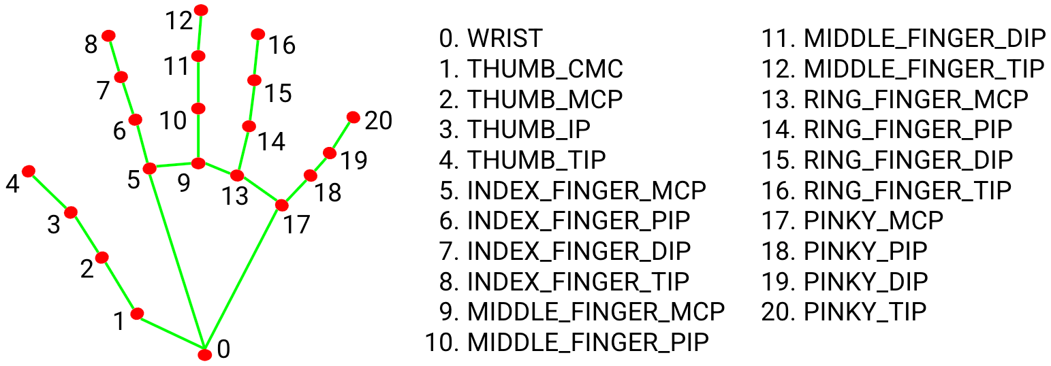
Methodology
MODULES USED
Media Pipe- Media Pipe is a cross-platform pipeline framework to build custom machine-learning solutions for live and streaming media.
CV Zone - Computer vision package that makes it easy to run Image processing and AI functions.
Pyauto GUI - which provides the ability to simulate mouse cursor moves and clicks as well as keyboard button presses.

Slide 13
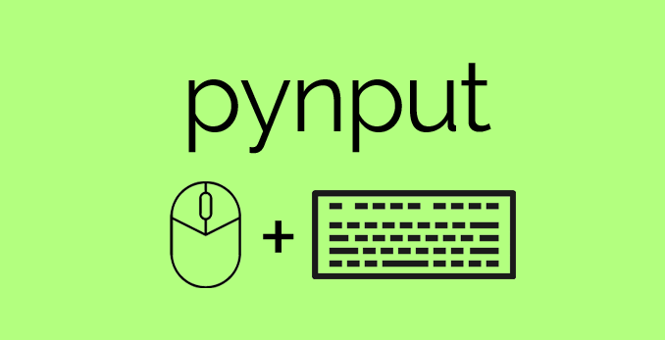

LIBRARIES USED
Pynput- The pynput library allows you to control and monitor/listen to your input devices such as the keyboard and mouse.
Pyttsx3- Pyttsx3 is a text-to-speech conversion library in Python. Unlike alternative libraries, it works offline and is compatible with both Python 2 and 3.

Slide 14
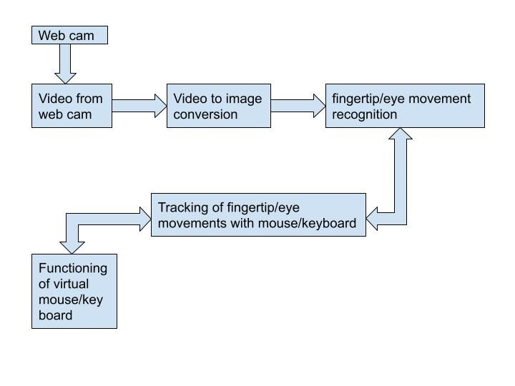
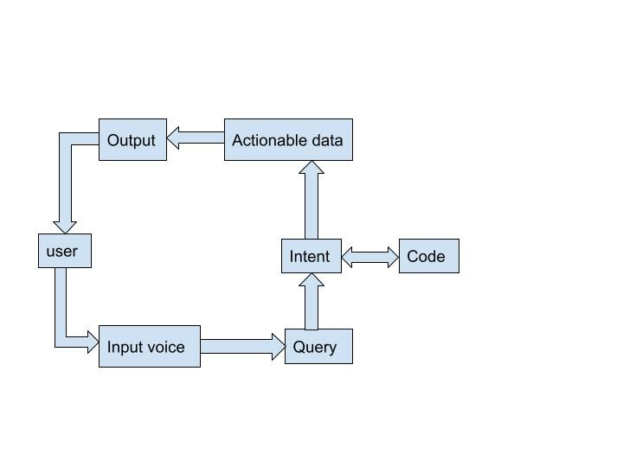
Architecture Diagrams
Gestures Voice Commands

Slide 15
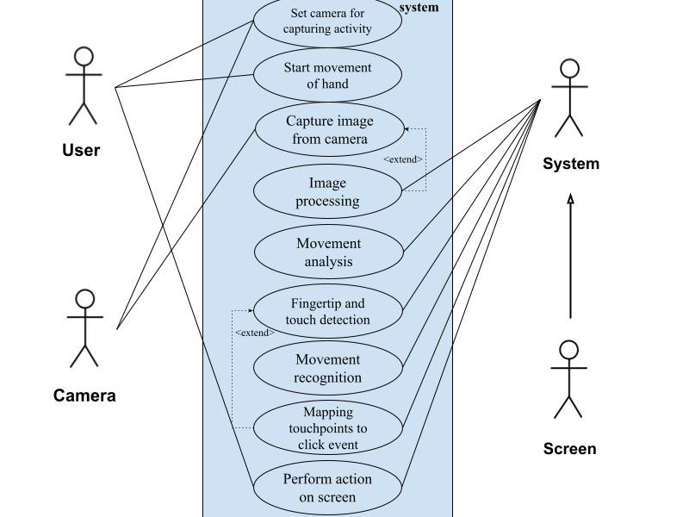
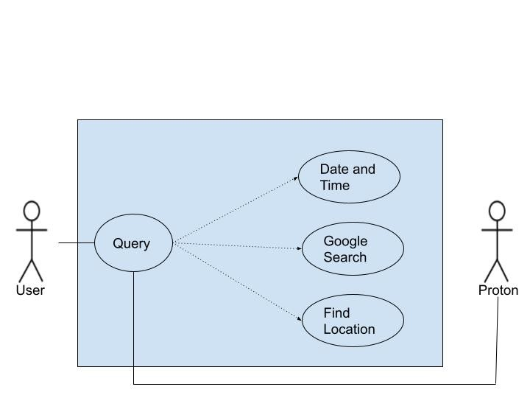
UML Diagrams-Use Case Diagrams
Gestures Voice Commands

Slide 16
Results
Utilizes modern ML and CV techniques to recognize hand gestures, voice commands, and eye movements.
Functions as a virtual keyboard and mouse without the need for a wire or any other external device,.
Enhances the user experience.
We have created a GUI which consists of the following features:
Voice Bot – allows controlling system through voice commands.
Keyboard – enables control keyboard using hand gestures.
Eye – allows controlling mouse operations using eye movements.
Gesture- controls mouse operations using hand gestures.

Slide 17
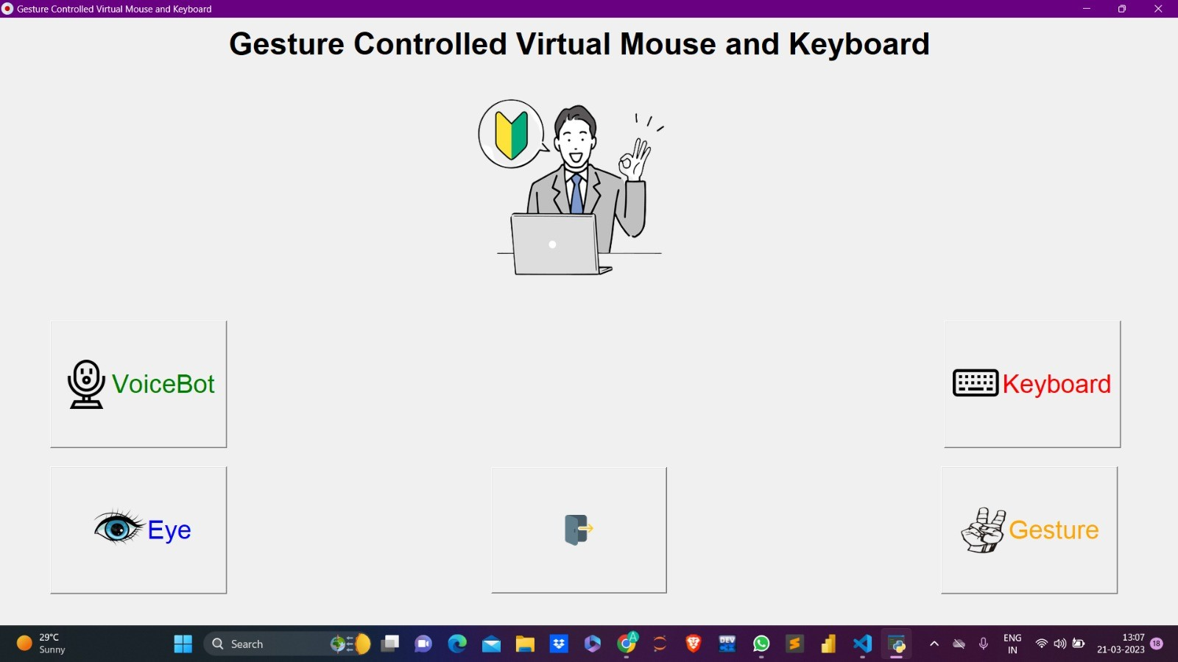
Graphical User Interface

Slide 18
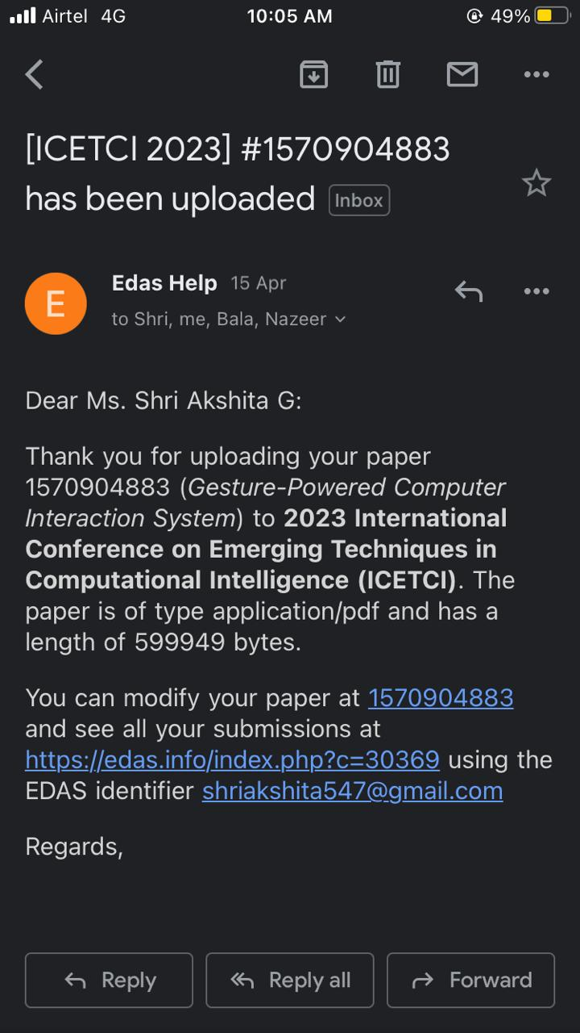
International Conference on Emerging Techniques in Computational Intelligence (ICETCI)

Slide 19
References
[7] Virtual Mouse Using Hand Gesture. International Research Journal of Engineering and Technology (IRJET); Abhilash S S; Lisho Thomas; NWCC-2021
[8] Gesture recognition and fingertip detection for human computer interaction, International Conference on Innovations in Information Embedded and Communication Systems (ICIIECS); R. M. Prakash; T. Deepa; T. Gunasundari and N. Kasthuri-2017
[9] A Survey of Fingertip Character Identification in Open-Air Using Image Processing and HCI", 2018 3rd International Conference for Convergence in Technology (I2CT); D. A. Barhate and K. P. Rane-2018
[10] Real Time Driver Fatigue Detection Based on Facial Behaviour along with Machine Learning Approaches, IEEE International Conference on Signal Processing Information Communication & Systems (SPICSCON); Dey Sanjay et al-2019.
[1] Virtual Mouse Control Using Colored Fingertips and Hand Gesture Recognition Vantukala VishnuTeja Reddy; Thumma Dhyanchand; Galla Vamsi Krishna; Satish Maheshwaram -2020
[2]. Real-time virtual mouse system using RGB-D images and fingertip detection Dinh-Son Tran ; Ngoc-Huynh Ho; Hyung-Jeong Yang; Soo-Hyung Kim & Guee Sang Lee-2020
[3]. Deep Learning-Based Real-Time AI Virtual Mouse System Using Computer Vision to Avoid COVID-19 Spread ;Shriram,B; Nagaraj,J Jaya,S; Shankar and P. Ajay-2021
[4]. Hand gesture recognition-based non-touch character writing system on a virtual keyboard Md. Abdur Rahim; Jungpil Shin & Md. Rashedul Islam- 2020
[5] Computer Cursor Control Using Eye and Face Gestures Akshada Dongrev Department of Information Technology, St. Francis Institute of Technology,Mumbai, India; Rodney Pinto; Ameya Patkar; Minal Lopes – 2020
[6] Human-machine interaction based on hand gesture recognition using skeleton information of Kinect sensor. Rahim M A; Shin J; Islam M R -2018

Slide 20
THANK YOU

